Slide 1
Electric Cars Presentation
Name
Date

Slide 2
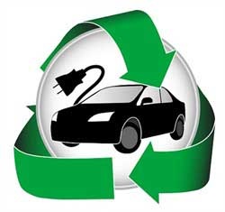
Introduction
An electric car is a general term that describes vehicles propelled by Electric Motors using electrical energy stored in batteries.
Electric Vehicles (Evs) don’t produce exhaust gases like combustion engines and this explains why they are regarded as environmentally friendly.
Its might sound unrealistic that the first EV was created in 1832.
An interesting fact is that it would cost a single buck for an EV to travel the same distance as a gallon of gas which averages around 3 bucks.
Fig: https://www.google.com/url?sa=i&url=https%3A%2F%2Fwww.activesustainability.com%2Fsustainable-life%2Fhow-much-does-an-electric-car-save%2F&psig=AOvVaw34MsRUIGdXcUPXI-XG_y2I&ust=1632776267762000&source=images&cd=vfe&ved=0CAsQjRxqFwoTCPiOit_DnfMCFQAAAAAdAAAAABAI

Slide 3

Functionality
These vehicles function as illustrated in the video below:

Slide 4
Today, these Evs have gained newfound popularity.
EV sales have significantly raised
  About 40% increase between 2019 and 2020
This is because of:
  increased fuel costs
  Evs availability in different models
  Affordability
These vehicles are changing the car industry
S&P Global says that there are 10 million Evs on the road.
Recent developments are putting Evs on the forefront, e.g. reduction of the cost of producing batteries.

Slide 5
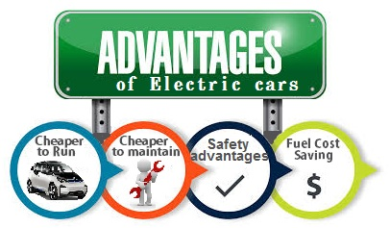

The Advantages

Slide 6
Advantages
So they basically Evs don’t have tailpipes, they don’t emit CO2
  This means their usage minimizes pollution; creating health environments for all living things.
  In a blog named JuiceBlog, it was found that in a year, a single EV on the roads can save an average 1.5 million grams of CO2.
Less expensive and less frequent maintenance (Ghasri et al., 2019).
Are quieter than engine combustion vehicles
Owners of Evs attract some tax credits (Ghasri et al., 2019).
Electricity is renewable as opposed to gasoline

Slide 7
Conti…
In some places, EV owners’ enjoy special highway lanes put aside for such vehicles.
  There are major highways that have HOV (high occupancy vehicle) lanes.
  These lanes help drivers bypass traffic in rush hour moments
  These lanes are called carpool lanes which favor EV drivers mostly
  Driving that vehicle warrants you to use this special lane
They improve air quality within towns and cities
Electric power used by Evs is reliable and uninterrupted
  It runs the vehicle continuously and efficiently

Slide 8
Types of EVs
Battery Electric Vehicles (BEVs)
  Obtain their power solely from a rechargeable battery
  No gas engine parts
  Capable of fast charging
  Zero emissions
Plug-in hybrid electric vehicles (PHEVs)
  Have larger battery and electric motor
  Has a gas tank and a charging port
Hybrid Electric Vehicles (HEVs)
  Recharges through the braking system and letting the internal combustion engine take over after the vehicle catches speed

Slide 9
Companies that have embraced Evs in the U.S.
These 3 companies are accountable for over 60% Evs sold in the U.S (Richter, 2021):
Tesla
  E.g. Tesla Model 3, Tesla Model S, and Tesla Model X
General Motors
  GMC Hummer EV SUV
  GMC Hummer EV sport utility truck
Nissan
  Nissan Leaf (most popular since 2011)
  Nissan e-NV200
  Nissan Nuvu

Slide 10
Conclusion
The future of the motor industry is Evs, that can be said without doubt.
These vehicles are environmentally friendly, cheaper to maintain, and are affordable.
Most developing economies of the world including China, Japan, United Kingdom, Sweden, Norway, Germany etc. propose implementing 100% sales of zero-emission vehicles.
California’s ZEV program is an example of enacted policy towards the campaigning for Evs.

Slide 11
References
Ghasri, M., Ardeshiri, A., & Rashidi, T. (2019). Perception towards electric vehicles and the impact on consumers’ preference. Transportation Research Part D: Transport and Environment, 77, 271-291.
James, Luke. Electromobilty- Electric vehicles basics, how they work and how they are powered. 04 02 2021. <https://power-and-beyond.com/electromobility--electric-vehicle-basics-how-they-work-and-how-theyre-powered-a-997269/?cmp=go-ta-art-trf-PuB-DSA-20210801&gclid=EAlalQobChMl2pqy0PKH8wlVkdayCh1mPQduEAAYASAAEglqKvD_BwE>.
JuiceBlog. Who are the Top Electric Car Companies? 19 October 2018. 18 September 2021. <https://evcharging.enelx.com/eu/about/news/blog/492-top-electric-cars>.
Richter, Felix. How many cars are on the road and whch country has the most? 07 May 2021. <https://www.weforum.org/agenda/2021/05/chart-that-is-the-state-of-the-global-electric-car-market>.

